Slide 1


Creativity
[Professor Name]
[Class and Section Number]
Notes:
Classroom Recommendations: This material could be covered in one 75-minute class period. If you are teaching in 50-minute class periods, you will either need to reduce the number of activities and discussion questions or split the information into two class periods. Please refer to the Lecture Framework in the Noba Instructor Manual for specific details.
Overview: The creativity module introduces students to basic concepts of creativity, such as how we determine is something is creative. The accompanying Instructor Manual provides material for your class, including activities and discussion questions, which are designed to help keep your students interested and engaged in the material. This instructor’s manual includes discussion questions and activities to help engage your students in the material, and it includes links to other resources that may help you design a great portion of your course.
Technical Note: These slides may contain simple click animation so that you can focus students’ attention on a particular question, a selection of text, or an image and not have them be distracted by reading ahead. You can either preview the sequence of animation by going through the slides in slideshow view, visiting the animations tab, or reviewing the slide notes. In the notes you will see a cue - (Click) – that corresponds to each animation.
You may also find hyperlinks to outside videos at various places in the slides. These hyperlinks are embedded in text and indicated by color and in the notes section.

Slide 2
Learning Objectives
Comprehend the three criteria that have to be satisfied to conclude that an idea is creative.
Appreciate some of the cognitive processes that provide the basis for creativity.
Know some of the personal characteristics of highly creative people.
Understand how certain social environments influence creativity.
Notes:
This slide outlines the learning objectives of the module.

Slide 3
Warmup Activity: Unusual Uses
Write down all the possible uses for the following object (other than the normal use):
A shoe
How many uses did you identify?
What are some of the unusual uses?
Notes:
The purpose of this slide is to facilitate an activity based on the Unusual Uses Test. Please note that there is no picture on this slide because that may bias students’ responses. Having a photo of a sneaker or a high heeled shoe will likely change students’ responses, which you could discuss after the activity.
(Click): Write down all the possible uses for the following object (other than the normal use):
Make sure students understand the instructions. You may want to add, “For example, the common use for a newspaper is for reading, but it could also be used for swatting flies, to line drawers, to make a paper hat and so on.”
(Click): A shoe
If you have time, you can have students do this for other objects, such as a brick (discussed in the module), a car tire, a hanger, a barrel, or a pencil.
(Click): How many uses did you identify?
This task may likely be difficult for some students and easier for other students.
(Click): What are some of the uses you identified?
Remembering some of the uses students identify here could be helpful in the next section when discussing the 3 criteria for creativity.

Slide 4
Overview
Elements of Creativity
Three Criteria
Types of Creativity
Cognitive Processes: How Do Creators Think?
Personal Characteristics: Who Is Creative?
Social Contexts
Notes:
The purpose of this slide is to provide students with an overview of the material that will be covered during the lecture

Slide 5

Creativity
Originality
Surprise
Usefulness
Notes:
This slide introduces the concept of creativity by going over the three criteria for creativity outlined in the module. Please note that these are listed in a different order than the module lists them, in order to facilitate a smooth transition into the discussion question on the next slide.
Three Criteria
The module outlines three criteria for creativity. It is based on the U.S. Patent Office uses. These are quantitative criteria, where an idea or invention could range from having absolutely none of one of these elements to having a lot of it.
(Click): Originality
How unique is the idea or product? The more unique, the more original it is. If there was an original idea discussed in the Unusual Uses Activity, refer back to it now.
(Click): Surprise
How surprising is it? At the very least, it should be nonobvious. You could ask students whether they were surprised by any of their fellow students’ responses in the Unusual Uses Activity.
(Click): Usefulness
How valuable is it? Does it work? The module gives an example of a parachute made out of concrete that would have no usefulness. Where there any ideas generated in the Unusual Uses Activity that weren’t particularly useful?

Slide 6

Creativity: Discussion
What about art and poetry?
Do they meet the criteria of usefulness?
Notes:
This slide outlines an optional discussion question, highlighting the criteria of usefulness.
Discussion question:
What about art and poetry? Do they meet the criteria of usefulness?
From the module:
“To be creative an idea must be useful. Although it is easy to see how a new invention can be useful, what does it mean for a scientific discovery or artistic composition to be useful? When, in 1865, Mendel discovered that the traits of peas were inherited according to genetic laws, what possible use could that finding have at the time? What conceivable utility could there be for a painting by Van Gogh or a poem by Dickinson? Should some other word be used, such as valuable or appropriate? Or, should we acknowledge that a theory, painting, or poem is useful in a different way than an invention? Can a new idea be creative just because it satisfies our intellectual curiosity or aesthetic appreciation?”

Slide 7
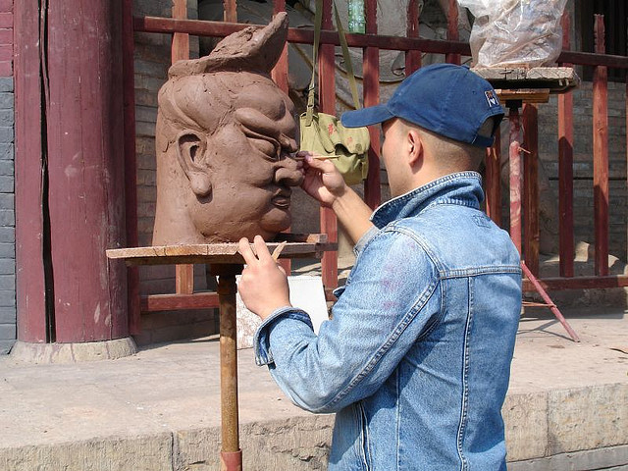
Types of Creativity
Little-c creativity
Big-C Creativity
Notes:
This slide introduces the concept “Big-C” and “little-c” C/creativity.
(Click): little-c creativity
Who decides whether something is creative? If the person who is creating the product/art/invention decides, this is “little-c creativity.” It’s subjective and personal.
(Click): Big-C Creativity
If someone other than the person who produces the product/art/invention decides whether it is creative, then it’s “Big-C Creativity.” This is an objective or consensual rating of creativity.

Slide 8
Overview
Elements of Creativity
Cognitive Processes: How Do Creators Think?
Remote Associates Test (RAT)
Unusual Uses Test
Personal Characteristics: Who Is Creative?
Social Contexts
Notes:
The purpose of this slide is to let students know what the next major topic will be.

Slide 9
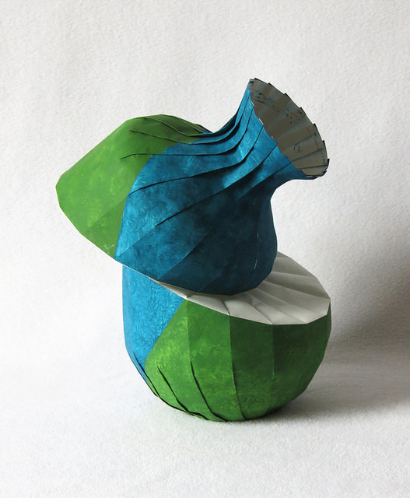
Cognitive Processes: How Do Creators Think?
Measuring Creativity
Remote Associates Test
Notes:
This slide begins the conversation about ‘How Do Creators Think?’ It identifies the first measure of creativity discussed in the module, the Remote Associates Test (RAT).
(Click): Measuring Creativity
In discussing how creators think, the module outlines two ways to measure creativity.
(Click): Remote Associates Test
One way to measure creativity is the Remote Associates Test. Some examples from the test are on the next two PowerPoint slides in an activity.

Slide 10
Activity: Remote Associates Test
You will see three words. Your job is to come up with a forth word that is somehow related to the first three words.
cream / skate / water
pie / luck / belly
Notes:
The purpose of this slide is to facilitate an activity based on the Remote Associates Test. For more examples from the RAT, go to http://www.remote-associates-test.com/. Please note that this test was developed in the 1960s, and the full version may include words that your students may not readily think of, such as ‘powderpuff,’ ‘dust bowl,’ and ‘cold cream.’
(Click): You will see three words. Your job is to come up with a forth word that is somehow related to the first three words.
Ask students to keep their answers to themselves, to give all students time to come up with an answer.
(Click): cream / skate / water
The answer, according to the RAT, is “ice.” RAT answers range from easy to very hard, and this one is considered easy. Depending on the time you have, you may give students a minute or two to come up with an answer.
(Click): pie / luck / belly
The answer is “pot.” This item is rated as being of medium difficulty.

Slide 11
Activity: Remote Associates Test
health / take / less
sore / shoulder / sweat
envy / golf / beans
fish / mine / rush
Notes:
This slide continues the Remote Associates Test Activity. Depending on how much time you have, you may or may not want to continue this activity.
(Click): health / take / less
The answer is “care.” This item is rated as being hard.
(Click): sore / shoulder / sweat
The answer is ‘cold.’ This item is rated as being very hard.
(Click): envy / golf / beans
The answer is “green.” This item is rated as being hard. This may also be an opportunity to talk about how SES may affect the results, as people who are not as familiar with golf may be less likely to identify ‘golf green.’
(Click): fish / mine / rush
The answer is “gold.” This item is rated as being very easy.

Slide 12
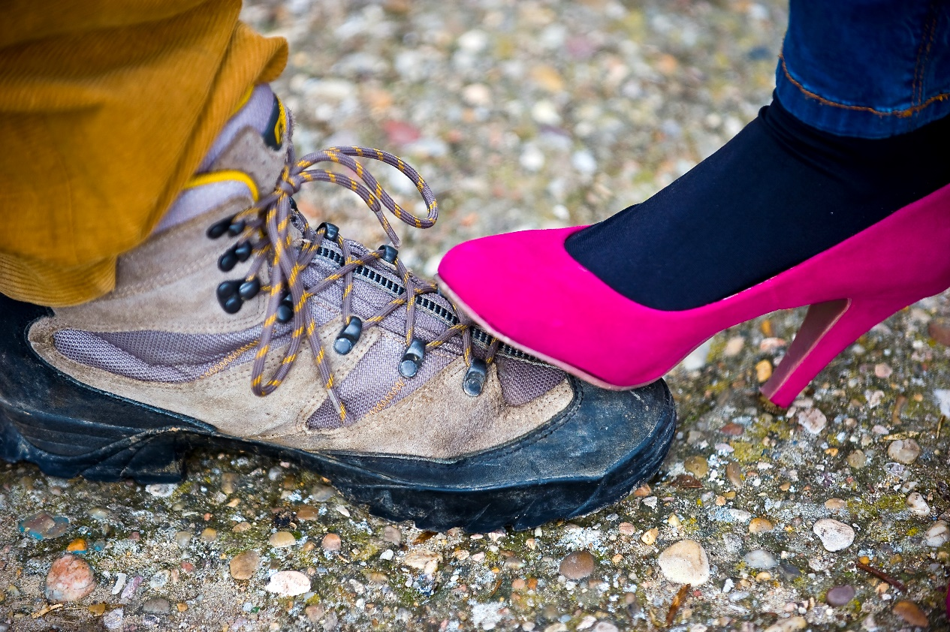
Cognitive Processes: How Do Creators Think?
Measuring Creativity
The Unusual Uses Test
Divergent Thinking
Notes:
This slide highlights the Unusual Uses Test. If you did the Unusual Uses Activity at the beginning of this PowerPoint, then refer back to it here.
(Click): Measuring Creativity
This is the 2nd measure of creativity discussed in the module – usefulness.
(Click): The Unusual Uses Test
As in the Unusual Uses Activity (see the activity at the beginning of this PowerPoint and the IM), the test asks individuals to come up with unusual uses for every day items, such as a brick (discussed in the module), a shoe (in the activity), a hanger, a car tire, a barrel, and a pencil. The uses are scored on 4 dimensions: fluency, originality, flexibility, and elaboration.
(Click): Divergent Thinking
This test is an example of divergent thinking. The Remote Associates Test is an example of convergent thinking, in which each question has one correct answer.

Slide 13

Discussion
What are some issues with trying to design a test of creativity?
Notes:
This slide presents students with a discussion question about the two tests of creativity outlined in the module.
Discussion Question:
Based on what you have learned about the Unusual Uses Test and the Remote Associates Test, what are some issues with trying to design a test of creativity?
This question is attempting to get students to think critically about the tests, as well as further understand the concept of creativity.

Slide 14
Overview
Elements of Creativity
Cognitive Processes: How Do Creators Think?
Personal Characteristics: Who Is Creative?
The “Creative Personality”
Creativity and Mental Illness
Social Contexts
Notes:
The purpose of this slide is to let students know what the next major topic will be.

Slide 15
Creativity Personality Scale (Gough, 1979)
Add one point if you check |  | Subtract one point if you check
Capable | Inventive | Artificial | Submissive
Clever | Original | Cautious | Suspicious
Confident | Reflective | Commonplace | Well-mannered
Egotistical | Resourceful | Conservative
Humorous | Self-confident | Conventional
Individualistic | Sexy | Dissatisfied
Informal | Snobbish | Honest
Insightful | Unconventional | Narrow interests
Intelligent | Wide interests | Sincere
Notes:
The purpose of this slide is to present the Creative Personality Scale of the Gough (1979) Adjective Check List. This is also Table 1 in the module.
Sometimes, creativity is measured by evaluating the associated personality characteristics. The adjective check list in this slide is one such effort. Higher scores indicate a more creative personality.
Reference:
Gough, H. G. (1979). A creative personality scale for the adjective check list. Journal of Personality and Social Psychology, 37, 1398–1405.

Slide 16

Personal Characteristics: Who Is Creative?
The “Creative Personality”
Openness-to-Experience
Reduced Latent Inhibition
Notes:
This slide highlights the idea of there being a ‘creative personality.’
(Click): The “Creative Personality”
Creativity correlates with some personality measures, leading some to believe that creativity is partially a personal attribute.
(Click): Openness-to-Experience
People who are high in creativity also tend to be high in openness-to-experience, one of the Big Five Personality Traits.
(Click): Reduced Latent Inhibition
Latent inhibition is the ability to not focus on extraneous details. However, creative people aren’t as good at latent inhibition, which may allow them to make connections and observations other people overlook.

Slide 17

Personal Characteristics: Who Is Creative?
Creativity and Mental Illness
Correlation
Need Domain Expertise for Big-C Creativity
Notes:
This slide allows instructors to discuss whether there is a connection between creativity and mental illness.
(Click): Creativity and Mental Illness
Is there a relationship between creativity and mental illness? This article (http://www.ncbi.nlm.nih.gov/pmc/articles/PMC4335301/) discusses why this is a difficult question to answer, including that both creativity and mental illness are broad concepts.
(Click): Correlation
Some studies do show a correlation between the two (and this is a good time to review what students can conclude from a correlation). However, not all people who are in creative occupations have a mental illness.
(Click): Need Domain Expertise for Big-C Creativity
As the module points out, a person cannot achieve Big-C Creativity without having knowledge and expertise in their chosen domain. At this point, you can discuss with your students how mental illness might make this difficult. Also, domain expertise alone will not help a person create Big-C Creativity.

Slide 18
Overview
Elements of Creativity
Cognitive Processes: How Do Creators Think?
Personal Characteristics: Who Is Creative?
Social Contexts
Exposure to Novel Stimuli
Multicultural Experiences
Sociocultural Systems
Notes:
The purpose of this slide is to highlight the next major topic.
You might remind students that outcomes are usually based on the person (nature) and the situation (nurture), and the same is true for creativity. The social contexts discussed next are the ‘nurture’ part of the equation.

Slide 19

Social Contexts
Novel Stimuli
Notes:
This slide begins the topic of how social contexts influence creativity.
Novel Stimuli
The module discusses a Ritter et al. (2012), an experiment where participants were in a virtual reality environment. Participants who were in the condition where the laws of gravity, for example, were violated had an increase in their cognitive flexibility, a component of creativity. Novel stimuli likely have a short-term effect on creativity.
Reference:
Ritter, S. M., Damian, R. I., Simonton, D. K., van Baaren, R. B., Strick, M., Derks, J., & Dijksterhuis, A. (2012). Diversifying experiences enhance cognitive flexibility. Journal of Experimental Social Psychology, 48, 961–964.

Slide 20
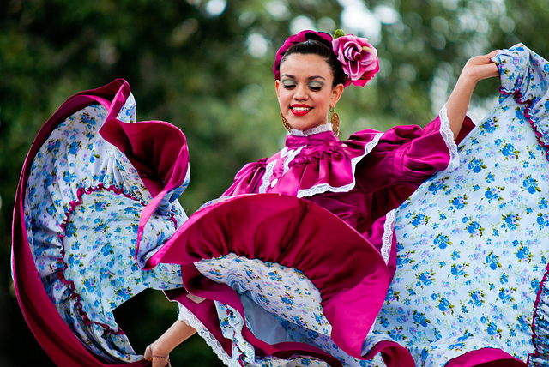
Social Contexts
Multicultural Experiences
Notes:
This slide continues the topic of how social contexts influence creativity, with the topic of multicultural experiences.
(Click): Multicultural Experiences
An example of a multicultural experience would be living in another country for an extended period of time. This will likely affect creativity if the person is also high on openness-to-experience.

Slide 21
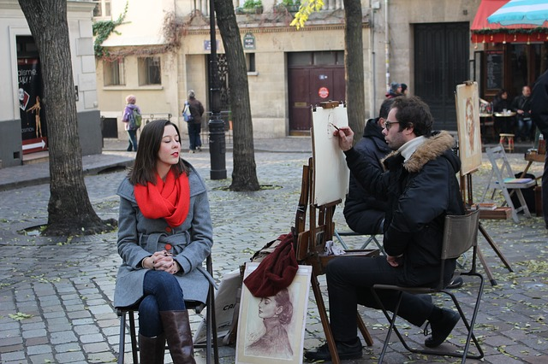
Social Contexts
Sociocultural Systems
How would you encourage creativity in our society?
Notes:
This slide continues the topic of how social contexts influence creativity, with the topic of sociocultural systems.
(Click): Sociocultural Systems
The sociocultural system, political, social, cultural, and economic factors, can be more or less encouraging of creativity. For example, think about the ‘Dark Ages’ versus the ‘Golden Age.’
(Click): How would you encourage creativity in our society?
This discussion question encourages students to apply what they have learned about creativity to this hypothetical situation.

Slide 22

CAT: One-Minute Paper
What was the most important thing you learned during this class?
What important question remains unanswered?
Notes:
Classroom Assessment Technique (CAT): One-Minute Paper
If you are presenting the information on one class day, you might end the material about here. End your class time with a one-minute paper.
The Minute Paper tests how students are gaining knowledge, or not. The instructor ends class by asking students to write a brief response to the following questions: “What was the most important thing you learned during this class?” and “What important question remains unanswered?”
Have students briefly answer these questions in writing and turn them in. After class, assess students’ responses. At the beginning of the next class, go over any misunderstandings or relevant questions.
If you do not conclude with this Classroom Assessment Technique (CAT), it would helpful to use another CAT. It could be in the form of a:
Muddy point
One-minute paper
Background knowledge
What’s the Principle?
Defining features Matrix:
For more information on CATs click here: http://cft.vanderbilt.edu/guides-sub-pages/cats/

Slide 23
Photo Attribution
Slide 1 | Photo Credit: Stars in the Desert JASON SEWARD https://www.flickr.com/photos/inkydigit/4178896850 https://creativecommons.org/licenses/by-nc-nd/2.0/
Slide 5 | Photo Credit: Chihuly Glass at DBG Casey Myers https://www.flickr.com/photos/eternalphotography/3460974793 https://creativecommons.org/licenses/by-nc-nd/2.0/
Slide 6 | Photo Credit: On creativity Linus Bohman https://www.flickr.com/photos/bohman/518729776 https://creativecommons.org/licenses/by/2.0/
Slide 7 | Photo Credit: A Sculpter [sic] Simon Hooks https://www.flickr.com/photos/gogap/422230164/ https://creativecommons.org/licenses/by-nc-sa/2.0/
Slide 9 | Photo Credit: Bent diagonal shift vase Rebecca Gieseking https://www.flickr.com/photos/65261618@N02/25531001976/ https://creativecommons.org/licenses/by/2.0/
Slide 12 | Photo Credit: Políticas de género Chema Concellón https://www.flickr.com/photos/concellon/12923006793 https://creativecommons.org/licenses/by-nc-nd/2.0/
Slide 13 | Photo Credit: Creativity is Key Jonathan Gross https://www.flickr.com/photos/jonathangrossphotography/15309580692 https://creativecommons.org/licenses/by-nd/2.0/
Slide 16 | Photo Credit: Artist Christian Senger https://www.flickr.com/photos/30928442@N08/9305100353 https://creativecommons.org/licenses/by-sa/2.0/
Slide 17 | Photo Credit: Artist Ade McOran-Campbell https://www.flickr.com/photos/ademc/1428808838 https://creativecommons.org/licenses/by-nc/2.0/
Slide 19 | Photo Credit: gravity. thatsmallphotographer https://www.flickr.com/photos/129236372@N07/16327474342 https://creativecommons.org/licenses/by-nc-nd/2.0/
Slide 20 | Photo Credit: Euphoric Dancer Ray_LAC https://www.flickr.com/photos/15132846@N00/5662961341 https://creativecommons.org/licenses/by/2.0/
Notes:
Photo Attribution Slide

Slide 24
Photo Attribution
Slide 21 | Photo Credit: Montmartre stinne24 https://pixabay.com/en/montmartre-painter-portrait-paris-239153/ https://creativecommons.org/publicdomain/zero/1.0/deed.en
Slide 22 | Photo Credit: Illustrated silhouette of a black cat nehtaeh79 http://www.freestockphotos.biz/stockphoto/16624 http://creativecommons.org/publicdomain/zero/1.0/
Notes:
Photo Attribution Slide

